Slide 1
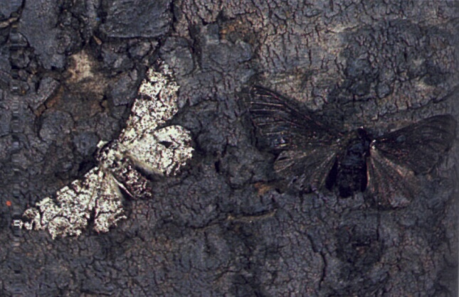
Natural Selection

Slide 2
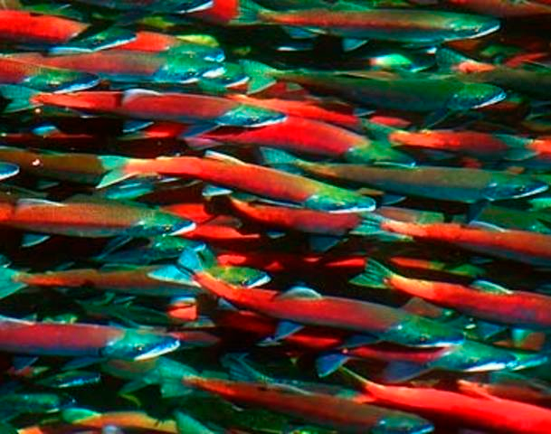
Natural Selection
Most organisms produce many more offspring than their habitat can support
If these offspring are produced by sexual reproduction they will show variations of characteristics; some of these characteristics will give the organism a better chance of survival than others
Individuals with the more desirable characteristics are said to be better adapted to the environment
Individuals with unfavourable characteristics will usually die before they are able to reproduce

Slide 3
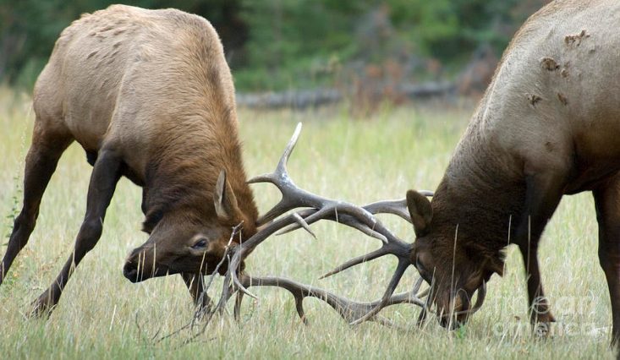
Natural selection
Biologists would say that the environment has selected certain characteristics for survival; this process is called natural selection & is sometimes referred to as survival of the fittest
This means that the best adapted individuals will survive in a particular environment
It does not always mean the largest, most muscular, and most physically fit individuals survive

Slide 4
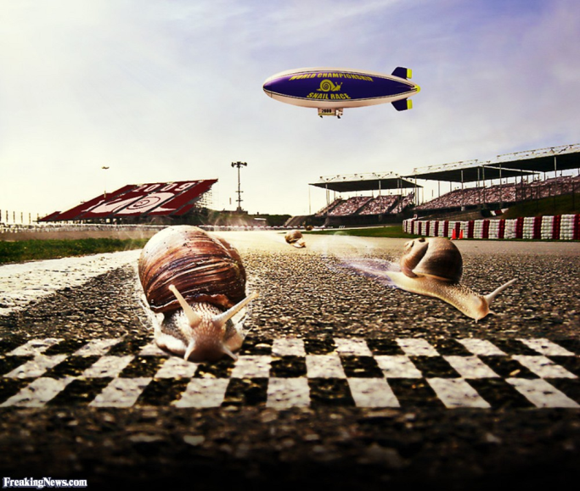
Natural selection
In some cases smaller or slower organisms may be better suited to a particular environment

Slide 5
Selection agents in the environment
The factors in an organisms environment that affect its survival are called selection agents. These agents can be divided into two groups:
Biotic agents
Abiotic agents

Slide 6
Biotic agents
Predators
Competition
Availability of food

Slide 7
Abiotic agents
Climate
Weather
Availability of oxygen
Availability of water
Availability of living space

